Slide 1
Introduction to Java Collections

Slide 2
Compiling Topics
Introduction
Equals and hashcode methods
Iterator and ListIterator class
What is Collection Framework?
Hierarchy of Collection Framework
Comparable and Comparator interface
Benefits of the Java Collections Framework
Questions

Slide 3
Introduction
Collections are like containers that groups multiple items in a single unit. For example; a jar of chocolates, list of names etc
The Java Collections Framework is a collection of interfaces and classes which helps in storing and processing the data efficiently.
Collections in java is a framework that provides an architecture to store and manipulate the group of objects.
Java Collection simply means a single unit of objects.
All the operations that you perform on a data such as searching, sorting, insertion, manipulation, deletion etc. can be performed by Java Collections.

Slide 4
Equals and Hashcode methods
Recall that boolean == method compares when applied to object compares references.
That is, two object are the same if the point to the same memory.
Since java does not support operator overloading, you cannot change this operator.
However, the equals method of the Object class gives you a chance to more meaningful compare objects of a given class.

Slide 5
Equals and Hashcode methods
Equals contract:
  It is reflexive: for any reference value x, x.equals(x) should return true.
  It is symmetric: for any reference values x and y, x.equals(y) should return true if and only if y.equals(x) returns true.
  It is transitive: for any reference values x, y, and z, if x.equals(y) returns true and y.equals(z) returns true, then x.equals(z) should return true.
  It is consistent: for any reference values x and y, multiple invocations of x.equals(y) consistently return true or consistently return false, provided no information used in equals comparisons on the object is modified.
  For any non-null reference value x, x.equals(null) should return false.

Slide 6
Equals and Hashcode methods
hashcode method
Java provides all objects with the ability to generate a hash code.
By default, the hashing algorithm is typically based on an integer representation of the java address.
This method is supported for use with java.util.Hashtable
Rules of overriding Hashcode method:
    Whenever invoked on the same object more than once, the hashCode method must return the same integer.
    If two objects are equal according to the equals(Object) method, then calling the hashCode method on each of the two objects must produce the same integer result.
    It is not required that if two objects are unequal according to the equals method, then calling the hashCode method on each of the two objects must produce distinct integer results.

Slide 7
Iterator class
Iterator interface provides the facility of iterating the elements in forward direction only.
Methods of Iterator interface:
  boolean hasNext(): it returns true if iterator has more elements.
  object next(): it returns the element and moves the cursor pointer to the next element.
  void remove(): it removes the last elements returned by the iterator. It is rarely used.

Slide 8
ListIterator class
An iterator for lists that allows the programmer to traverse the list in either direction, modify the list during iteration, and obtain the iterator's current position in the list
Methods of Iterator interface:
  boolean hasNext(): it returns true if iterator has more elements.
  boolean hasPrevious(): Returns true if this list iterator has more elements when traversing the list in the reverse direction.
  object next(): it returns the element and moves the cursor pointer to the next element.
  void add(E e): Inserts the specified element into the list (optional operation).
  void remove(): it removes the last elements returned by the iterator. It is rarely used.

Slide 9
ListIterator class
Methods of Iterator interface:
  int nextIndex(): Returns the index of the element that would be returned by a subsequent call to next().
  int previousIndex(): Returns the index of the element that would be returned by a subsequent call to previous().
  E previous(): Returns the previous element in the list and moves the cursor position backwards.
  void set(E e): Replaces the last element returned by next() or previous() with the specified element (optional operation).

Slide 10
What is Collection framework?
Provides ready made architecture.
Represents set of classes and interface.
Represents a unified architecture for storing and manipulating group of objects

Slide 11
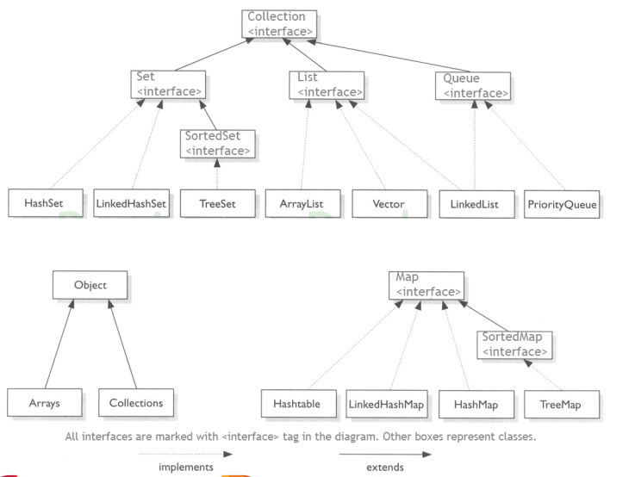
Hierarchy of Collection Framework

Slide 12
Collection Interface
The Collection interface is used to pass around collections of objects where maximum generality is desired. For example, by convention all general-purpose collection implementations have a constructor that takes a Collection argument. This constructor, known as a conversion constructor, initializes the new collection to contain all of the elements in the specified collection, whatever the given collection's sub interface or implementation type. In other words, it allows you to convert the collection's type.
Methods in Collection Interface:
  public boolean add(Object element): Is used to insert an element in this collection.
  public boolean addAll(Collection c): Is used to insert the specified collection elements in the invoking collection.

Slide 13
Collection Interface
Methods in Collection Interface:
  boolean remove(Object element): Is used to delete an element from this collection.
  boolean removeAll(Collection c): Is used to delete all the elements of specified collection from the invoking collection.
  boolean retainAll(Collection c): Is used to delete all the elements of invoking collection except the specified collection.
  int size(): Return the total number of elements in the collection.
  void clear(): Removes the total no of element from the collection.
  boolean contains(Object element): Is used to search an element.
  boolean containsAll(Collection c): Is used to search the specified collection in this collection.

Slide 14
Collection Interface
Methods in Collection Interface:
  Iterator iterator(): Returns an iterator.
  Object[] toArray(): Converts collection into array.
  boolean isEmpty(): checks if collection is empty.
  boolean equals(Object element): Matches two collection.
  int hashCode(): Returns the hashcode number for collection.

Slide 15
List
A List is an ordered Collection (sometimes called a sequence).
Lists may contain duplicate elements.
Elements can be inserted or accessed by their position in the list, using a zero-based index.
  ArrayList
  LinkedList

Slide 16
List
Methods in List:
  void add(int index,Object element): It is used to insert element into the invoking list at the index passed in the index.
  boolean addAll(int index,Collection c): It is used to insert all elements of c into the invoking list at the index passed in the index.
  object get(int index): It is used to return the object stored at the specified index within the invoking collection.
  object set(int index,Object element): It is used to assign element to the location specified by index within the invoking list.
  object remove(int index): It is used to remove the element at position index from the invoking list and return the deleted element.
  ListIterator listIterator(int index): It is used to return an iterator to the invoking list that begins at the specified index.

Slide 17
ArrayList Class
ArrayList class uses a dynamic array for storing the elements
Java ArrayList class can contain duplicate elements.
Java ArrayList class maintains insertion order.
Java ArrayList class is non synchronized.
Java ArrayList allows random access because array works at the index basis.
In Java ArrayList class, manipulation is slow because a lot of shifting needs to be occurred if any element is removed from the array list.

Slide 18
ArrayList Class
Constructors in ArrayList class:
  ArrayList(): It is used to build an empty array list.
  ArrayList(Collection c): It is used to build an array list that is initialized with the elements of the collection c.
  ArrayList(int capacity): It is used to build an array list that has the specified initial capacity.
Methods in ArrayList class:
  void add(int index, Object element): It is used to insert the specified element at the specified position index in a list.
  boolean addAll(Collection c): It is used to append all of the elements in the specified collection to the end of this list, in the order that they are returned by the specified collection's iterator.
  void clear(): It is used to remove all of the elements from this list.

Slide 19
ArrayList Class
Methods in ArrayList class:
  int lastIndexOf(Object o): It is used to return the index in this list of the last occurrence of the specified element, or -1 if the list does not contain this element.
  Object[] toArray(): It is used to return an array containing all of the elements in this list in the correct order.
  Object[] toArray(Object[] a): It is used to return an array containing all of the elements in this list in the correct order.
  boolean add(Object o): It is used to append the specified element to the end of a list.
  boolean addAll(int index, Collection c): It is used to insert all of the elements in the specified collection into this list, starting at the specified position.
  int indexOf(Object o): It is used to return the index in this list of the first occurrence of the specified element, or -1 if the List does not contain this element.

Slide 20
ArrayList Class
Example of ArrayList:
import java.util.*;
class ArrayListExample{
public static void main(String args[]){
ArrayList<String> nameList=new ArrayList<String>();
al.add("Ravi");
al.add("Vijay");
al.add("Ravi");
al.add("Ajay");
for(String obj:nameList)
System.out.println(obj);
ArrayList<String> cityList=new ArrayList<String>();
al2.add("Pune");
al2.add("Mumbai");
nameList.addAll(cityList);//adding second list in first list
for(String obj:nameList)
System.out.println(obj);
cityList.removeAll();
}

Slide 21
LinkedList Class
Java LinkedList class uses doubly linked list to store the elements.
Java LinkedList class can contain duplicate elements.
Java LinkedList class maintains insertion order.
Java LinkedList class is non synchronized.
In Java LinkedList class, manipulation is fast because no shifting needs to be occurred.
Java LinkedList class can be used as list, stack or queue.

Slide 22
LinkedList Class
Constructors in LinkedList class:
  LinkedList() : It is used to construct an empty list.
  LinkedList(Collection c) : It is used to construct a list containing the elements of the specified collection, in the order they are returned by the collection's iterator.
Methods in LinkedList class:
  void add(int index, Object element): It is used to insert the specified element at the specified position index in a list.
  void addFirst(Object o): It is used to insert the given element at the beginning of a list.
  void addLast(Object o): It is used to append the given element to the end of a list.

Slide 23
LinkedList Class
Methods in ArrayList class:
  boolean add(Object o): It is used to append the specified element to the end of a list.
  boolean contains(Object o): It is used to return true if the list contains a specified element.
  boolean remove(Object o): It is used to remove the first occurence of the specified element in a list.
  Object getFirst(): It is used to return the first element in a list.
  Object getLast(): It is used to return the last element in a list.
  int indexOf(Object o): It is used to return the index in a list of the first occurrence of the specified element, or -1 if the list does not contain any element.
  int lastIndexOf(Object o): It is used to return the index in a list of the last occurrence of the specified element, or -1 if the list does not contain any element.

Slide 24
Set
A Set is a Collection that cannot contain duplicate elements.
There are three main implementations of Set interface: HashSet, TreeSet, and LinkedHashSet.
HashSet, which stores its elements in a hash table.
TreeSet, which stores its elements in a red-black tree, orders its elements based on their values
LinkedHashSet, which is implemented as a hash table with a linked list running through it, orders its elements based on the order in which they were inserted into the set (insertion-order).
  HashSet
  LinkedHashSet
  TreeSet

Slide 25
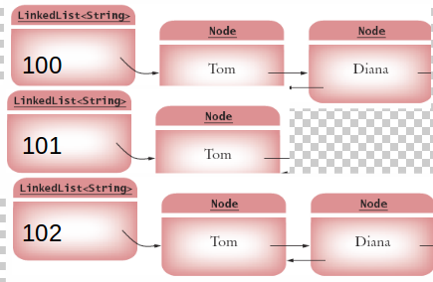
Hash Concept
Set elements are grouped into smaller collections of elements that share the same characteristic .
HashCode method - To identify the bucket number .
Equals method - If multiple elements have the same hash code, they are stored in a Linked list .If elements must also have an equals method for checking whether an element equals another

Slide 26
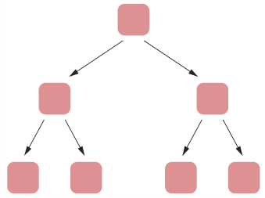
Tree Concept
Set elements are kept in sorted order
    Nodes are not arranged in a linear sequence but in a tree shape .
    In order to use a TreeSet, it mush be possible to compare the emlements and determine which one is “larger” .

Slide 27
HashSet Class
Implements Set Interface.
add elements with add(Object) method
contains(Object) is redefined to first look for duplicates.
if duplicate exists, Object is not added
What determines a duplicate?
careful here, must redefine both hashCode() and equals(Object)!
LinkedHashSet Class
LinkedHashSet class extend HashSet Class.
LinkedHashSet maintains insertion order of elements much like List interface .

Slide 28
Tree Concept
Set elements are kept in sorted order
    Nodes are not arranged in a linear sequence but in a tree shape .
    In order to use a TreeSet, it mush be possible to compare the emlements and determine which one is “larger” .

Slide 29
TreeSet Class
Another concrete set implementation in Java is TreeSet.
Similar to HashSet, but one advantage:
    While elements are added with no regard for order, they are returned (via iterator) in sorted order.
    What is sorted order?
        this is defined either by having class implement Comparable interface, or passing a Comparator object to the TreeSet Constructor.
        Latter is more flexible: doesn’t lock in specific sorting rule, for example. Collection could be sorted in one place by name, another by age, etc.

Slide 30
TreeSet Class
Another concrete set implementation in Java is TreeSet.
Similar to HashSet, but one advantage:
    While elements are added with no regard for order, they are returned (via iterator) in sorted order.
    What is sorted order?
        this is defined either by having class implement Comparable interface, or passing a Comparator object to the TreeSet Constructor.
        Latter is more flexible: doesn’t lock in specific sorting rule, for example. Collection could be sorted in one place by name, another by age, etc.

Slide 31
Comparable and Comparator Interface
Many java classes already implement comparable interface. Try String, Character, Integer, etc.
Your own classes will have to do this explicitly:
  Comparable defines the method
public int compareTo(Object other);
  Comparator defines the method
public int compare(Object a, Object b);

Slide 32
Map Interface
Maps are similar to collections but are actually represented by an entirely different class hierarchy.
Maps store objects by key/value pairs:
    map.add(“1234”, “Andrew”);
    ie Object Andrew is stored by Object key 1234
Keys not be duplicated
Each key map to only one value

Slide 33
Map Interface methods
void clear()
boolean containsKey(Object)
boolean containsValue(Object)
Set entrySet()
boolean get(Object)
boolean isEmpty()
Set keySet()
Object put(Object, Object)
void putall(Map)
Object remove(Object)
int size()
Collection values()

Slide 34
Map implementation
HashMap
A hashtable implementation of a map good for quick searching where order doesn’t matter.
Must override hashCode and equals
TreeMap
A tree implementation of a map Good when natural ordering is required
Must be able to define ordering for added elements.
LinkedHashMap
A Linkedhashtable implementation of a map good for quick searching where order matter.
Must override hashCode and equals.

Slide 35
Questions ?

Slide 36
Thank you !

